Slide 1
1
HOSTEL ACCOMMODATION SYSTEM
SUBMITTED TO
SUBMITTED BY
Mr Shailesh panwar
MD MINHAJ ALAM
B. Tech(it)
2nd year (4th Sem)
Session 2020-2024
Department of Information and technology &
School of Engineering and Technology
H.N.B.Garhwal University, Srinagar(Garhwal), Uttarakhand

Slide 2
CONTENTS
2
Introduction - Hostel Accommodation System
Login portal
Home
Login
Administrator login
Student login
Conclusion

Slide 3
Hostel Accommodation System
3
INTRODUCTION
As the name specifies “HOSTEL ACCOMMODATION SYSTEM” is a software developed for managing various activities in the hostel.
For the past few years, the number of educational institutions are increasing rapidly.
Thereby the number of hostels are also increasing for the accommodation of the students studying in the institution.
And hence there is a lot of strain on the person who are running the hostel and software is not usually used in this context.
This particular project deals with the problems on managing hostel and avoids the problems which occur when carried manually.

Slide 4
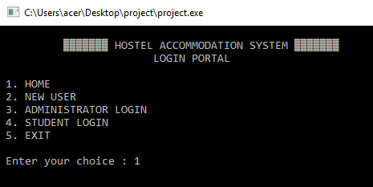
Login Portal
4
1.Home
2.New User
3.Administrator
Login
4.Student Login
5.Exit

Slide 5
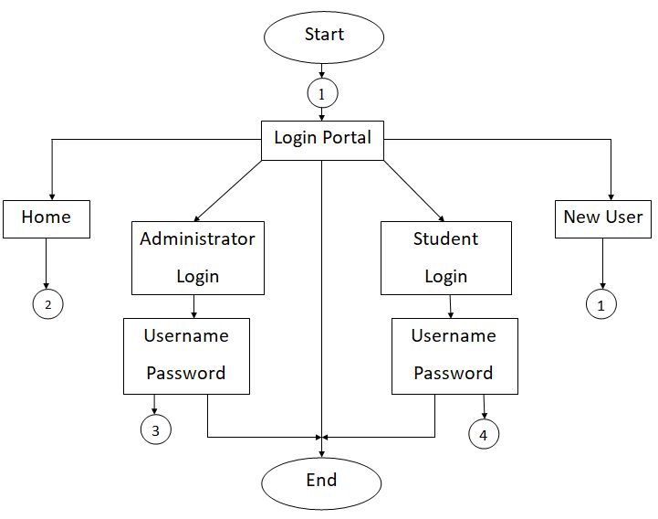
Login Portal
5

Slide 6
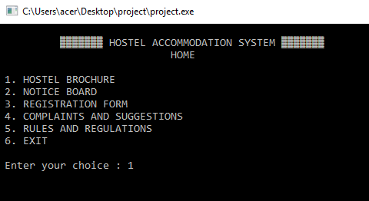
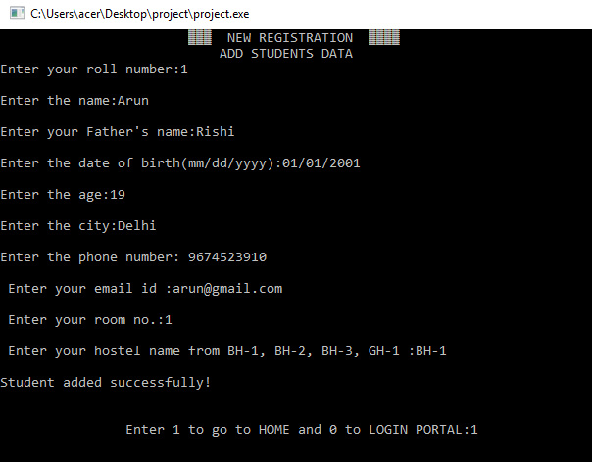
HOME
6
1.Hostel Brochure
2.Notice Board
3.Registration Form
4.Complaints and
Suggestions
5.Rules and Regulations
6.Exit

Slide 7
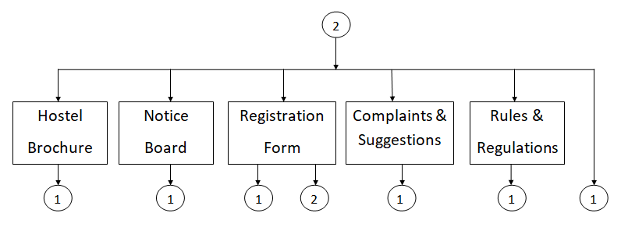
HOME
7

Slide 8
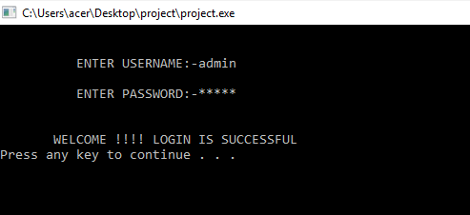
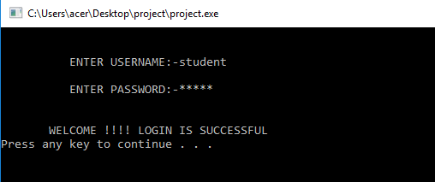
LOGIN
8
Admin login
Student login

Slide 9
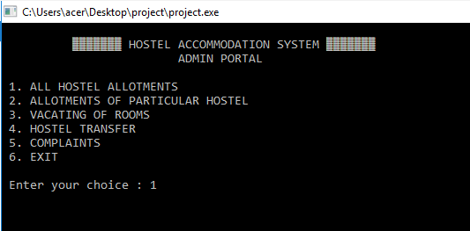
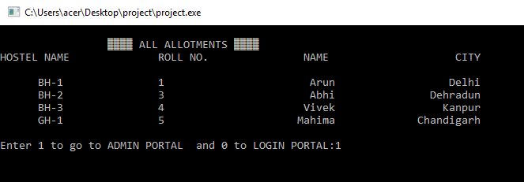
Administrator Login
9
1.All hostel allotments
2.Allotments of
particular hostel
3.Vacating of rooms
4.Hostel transfer
5.Complaints
6.Exit

Slide 10
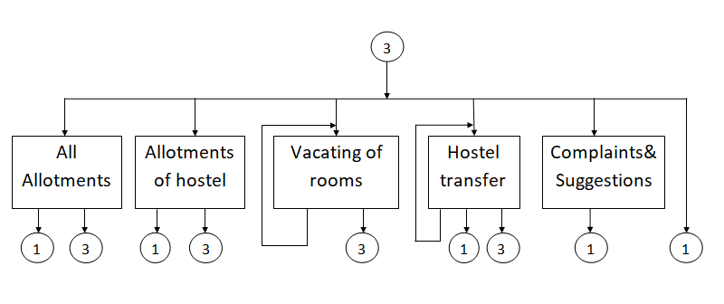
Administrator Login
10

Slide 11
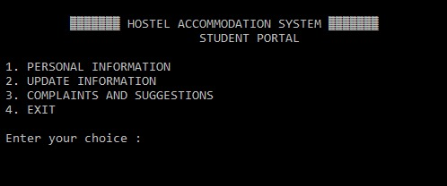
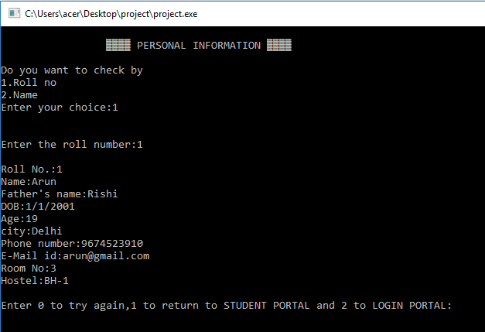
Student Login
11
1.Personal Information
2.Update Information
3. Complaints and
Suggestions
4.Exit

Slide 12
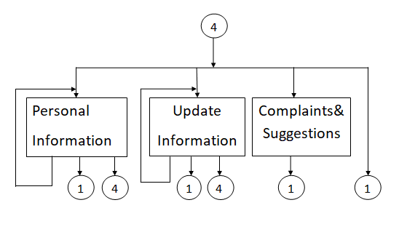
Student Login
12

Slide 13
Conclusion
13
The project, developed using 'C Language' is based on the requirement specification of the user and the analysis of the existing system, with flexibility for future
enhancement.
Identification of the drawbacks of the existing system leads to the designing of computerized system that will be compatible to the existing system with the system which is more user friendly.

Slide 14
References
14
www.academia.edu
www.codewithc.com
www.tutorialspoint.com

